Slide 1
What is Wrecking Your Data Plan?
A Measurement Study of Mobile Web Overhead
Abner Mendoza
SUCCESS Lab
Texas A&M University
Kapil Singh
IBM Research
Guofei Gu
SUCCESS Lab
Texas A&M University
Mingwei Wei 2120141061
Notes:
Good morning. I will introduce a paper included in INFOCOM2015 named What is wrecking your data plan? A measurement study of mobile web overhead.

Slide 2

Content
Abstract
An Analysis of Unnecessary Overhead Sources
Measurement Framework
Experimental Results
Discussion & Future Work
Notes:
My content includes five parts. Let me introduce abstract at first, then analyze the unnecessary overhead sources, after know what is unnecessary, the next step is find a way to detect them, so we propose a measurement framework. i will show the experimental results later and make discussion at last.

Slide 3







Abstract
response
Server
request
Clients
User often face a monetary cost associated with the data downloaded to their mobile habitat.
vs
23% or more of the content size on an average website is unnecessary.
100,000 popular sites
Notes:
The growing popularity of smartphone and user demand for a rich web experience has result in the surge in cellular bandwidth requirements. While many websites have adapted to the new mobile habitat, they often take shortcuts to transition from their desktop to mobile version, many times carrying redundant content that is never used. So mobile users are often paying for certain undesirable content, in the form of their bandwidth costs.
In this paper, we study the composition and complexity of modern websites, from both desktop and mobile perspective, to identify the wasted bandwidth. We developed a crawler-based framework to perform analysis of the 100 000 popular sites and results show 23% or more of the content size is unnecessary, unused or redundant.

Slide 4


An Analysis of Unnecessary Overhead Sources
A. Methodology
Overhead
Not rendered by browser
Have no visual or functional impact on the offerings of the web
Content is not directly related to page and presents limited to no value to user
Focus on the content size!
Goal
We don’t consider timing and latency.
Identify total added bandwidth consumed by data that is redundant.
Notes:
Before detecting unnecessary data, we should know what is unnecessary, right? So we establish the following principle to guide our overhead measurement. A piece of content is considered unnecessary overhead if it satisfied at least one of the following conditions. The first .. The second .. And the last .. We evaluate page resources against the three conditions and marked them as unnecessary if one of the conditions are satisficed.
Indeed, our work is related to performance measurement study, but with several key differences. Most significantly, we don’t consider timing and latency. Instead, we focus on the content size of assets transferred over the network. Our goal is just to identify total added bandwidth consumed by data that is redundant and costly to the user.

Slide 5
An Analysis of Unnecessary Overhead Sources
B. Resources contributing to Unnecessary Overhead
1
Image, the major contributors to total page size
Often not use image compression techniques
2
Unreachable code in JavaScript and CSS
Code coverage
JavaScript
CSS
3
Advertisements introduces additional bytes that must be downloaded for each website
4
Image
Fonts
HTML
Cookies
Unused Fonts
5
Comments and Whitespaces in HTML, JavaScript and CSS have no value to user
6
Improper use of Cookies
Notes:
Modern web pages include a rich variety of content types, for our analysis, we focus on six major components of a website. Since our evaluation shows that on average, they make up to 95% or more of the total size of website.
The first is image overhead, they are major contributors to the total page size with contributions of 63% and 64% of the total page weight for desktop and mobile sites respectively. Even though several image compression techniques exist, they are often not utilized by web developers.
The second is unreachable code in JavaScript and CSS, many websites use the same code base for both desktop and mobile version that often results in code that remains included but never used.
The third is advertisements. They introduce additional bytes that must be downloaded for each website, which effectively represents an additional cost to the end users.
The fourth is unused font, web fonts are included on a page as an external font file that is downloaded by the browser, these font files include a large set of possible fonts, even though the site does not consume all of them.
The fifth is comments and whitespaces in HTML, JavaScript and CSS, they are important to web developer, but have no value to the end user.
The last is improper use of cookies, in many cases the server doesn’t require all the cookies in order to serve the requested content.

Slide 6




Measurement Framework
Internet
Alexa Site Listings
NOTES
HAR
Files
Raw
Files
crawler
Perform an in-depth analysis of the top 100,000 popular sites ranked by Alexa.
Page
Archives
HAR
Request-response pairs
JSCover Proxy
Notes:
We built a customized framework used to crawl and capture all requests and responses, and subsequently analyze the raw data. Another major component in the framework is JSCover proxy, which is a tool that enables us to measure code coverage for JavaScript.

Slide 7





Measurement Framework — measurement approach
Content length for a given response.
At the time the web pages were crawled
online
Content size across different MIME types such as Image, JavaScript, CSS, HTML and Fonts.
After website are crawled
Results from code coverage and image optimization.
offline
Notes:
We analyzed each web page with respect to various metrics that measures the impact on data usage on desktop and mobile devices.
Some measurements were performed at the time the web page were crawled. For example, we calculate the content length at the time of crawling since HTTP headers sometimes report incorrect content length for a given response. We also measured the content size online across different MIME types.
Other measurements, such as those resulting from code coverage and image optimization, are done offline after the websites are crawled.

Slide 8




Measurement Framework — measurement approach
Code Coverage
Images
Advertisements
reduction
= original image size
- Size after optimized
Detect advertisement with tools
Measure and analyze their size overhead
Lossless
compression
Ad block
Notes:
For JavaScript coverage, we used the JSCover tool to find unused JavaScript code. JSCover is an open source tool that you can find it on github. JSCover saves the resulting coverage report to disk and we are then able to parse these report to infer lines of code not covered.
For images and web fonts measurements, we use compression tools that optimize the files by applying lossless compression. And we also use compression tools to strip out whitespace and comments for JavaScript, CSS and HTML.
In order to measure advertisements, we first needed to detect what portion of each website represented an advertisement. We used popular filter list used by ad blocker, so we are able to extract the segments that are identified as advertisements to measure and analyze their size overhead.

Slide 9
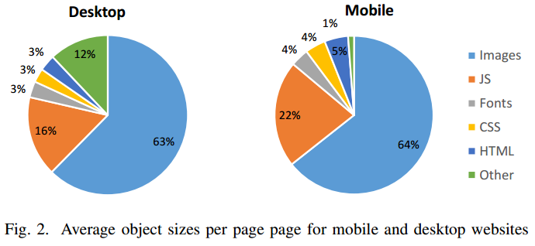
Experimental Results
Average size of a mobile website is 923 kilobytes
Average size of a desktop website is 1741 kilobytes
Images make up the majority of the total page weight on average website
The prominence of JavaScript code in both mobile and desktop sites
Notes:
While the focus of our work is mobile due to its higher per-byte data cost, the insights from this study can also equally benefit desktop websites design practices. Our measurements show that the average size of a mobile website is 923 kilobytes, and the desktop is 1741 kilobytes.
Previous studies have shown that images make up the majority of the total page weight on the average website. From fig 2, we also see the prominence of JavaScript code in both mobile and desktop sites. It is interesting to note that mobile websites use relatively more JavaScript code, which could give rise to concerns related to performance bottlenecks and overhead.

Slide 10




Experimental Results — image analysis
finance
63%
entertainment
64%
63% and 64% of the total page weight for desktop and mobile sites
Entertainment websites most and finance websites least
Images are rarely optimized by most websites.
GIF, PNG, JPG tend to be the most popular.
Image compression
Notes:
Since images are the majority contributors to the page weight, their impact on data usage is significant. Images take up about 63% and 64% of total page weight for desktop and mobile sites respectively. We found that entertainment websites use a larger volume of image and finance websites have the least average image size.
We found that three formats – GIF, PNG, JPG – tend to be the most popular.
Despite best practice recommendations, our analysis shows that images are rarely optimized by most websites.

Slide 11







Experimental Results — image analysis
1
OptiPNG
2
>
The most popular 640*960 screen
Images exceeded
640x960
121kilobytes (15.1%)
Image optimization is lacking on most websites
save
263kilobytes (13.1%)
Notes:
In terms of reducing bytes, one intuition is that converting GIF to 8-bit PNG can result in reduced image sizes while still preserving quality. We used OptiPNG image compression tool to convert GIF to PNG, and we saw an average of 13% file size reduction. Next, we ran the compression tool on existing PNG images and found a significant reduction in file size at about 31% on average.
Considering image dimensions, we found that a significant number of images exceeded the most popular 640x960 screen resolution. So image size reduction can be further enhanced if the image quality is appropriately optimized for the target screen quality.

Slide 12


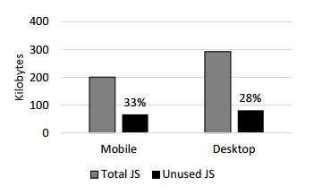


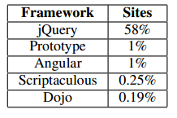
Experimental Results — analysis of code usage
CSS compression
Unused CSS rules
What contributes to unused code?
JavaScript framework libraries
85kilobytes (9.2%)
save
104kilobytes (6%)
Notes:
For analysis of code usage, based on code coverage analysis, we found that up to 33% of JavaScript code remains unused on mobile web pages and 28% on desktop. So we want to know what contributes to unused code? From our analysis, we noted that in many instances unused code is attributed to blocks of code from JavaScript framework libraries. In our mobile dataset, we found that 58% of sites made use of some form of the jQuery framework. The top 5 libraries we identified are shown in table.
For CSS, there are two main methods of reducing the size of CSS files. First, the CSS files can be compress similar to JS files by using tools. And second, we can analysis of CSS specificity rules to determine the unused CSS rules. On mobile sites, we found the average was 71% of the rules not used.
In summary, with regard to the total overhead for unused code (include JS and CSS), our results show that a total savings of 9.2% can be achieved on mobile websites, and 6% can be achieved on desktop.

Slide 13





Experimental Results — analysis of code usage
advertisement
Related to JavaScript, CSS, fla, image……
75kilobytes on mobile web pages; 153 kilobytes on desktop web pages
Mobile 86221 font files
Desktop 137799 font files
Half of all are not use
Sfntly to apply compression
Web fonts
Notes:
We also quantify the contribution of advertisement content to the total weight of a page. We found that advertisements account for about 10% of the total page weight. It consume an average of 75 kilobytes on mobile web pages, and 153 kilobytes on desktop pages.
Recent trends point to increasing adoption of web fonts across the web. Web fonts consist of external font files downloaded by the browser and utilized on a website through CSS rules. We found that over half of all font files are not utilized by browser in rendering the landing page, meaning they present significant overhead in terms of page size. So we use the open source sfntly library from Google to apply compression to our font files. After using this tool, font file were reduced by 40.3% for desktop sites and 29.4% for mobile.

Slide 14
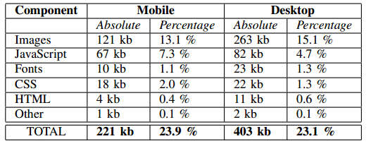
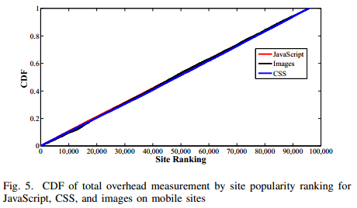
Experimental Results — measurements insights
Average websites suffer from a substantial overhead of more than 23%
Site ranking have little bearing on the overhead measurement
Notes:
The aggregated measurement results show that websites carry a significant overhead of redundant data. From table, not surprisingly, images and JavaScript carry the most overhead of all components. Overall, our results show that on an average websites suffer from a substantial overhead of more than 23%, thus motivating the urgent need to employ data optimization techniques.
And there is a interesting thing I want to add, from fig 5, we see a CDF of the overhead for JavaScript, CSS and images on mobile sites according to sites’ ranking. The site ranking seem to have little bearing on the overhead measurement, meaning both higher and lower ranked sites have almost equal tendency to exhibit similar overhead measurement.

Slide 15





Discussion & Future Work
VS
Reduce latency by minimizing the number of HTTP request
Concentrate on content size to find overhead of the various websites
performance
overhead
Concatenate files dynamically at run-time
Improve latency, page load time
Download a set of files left unused
Remove unused and redundant data
Automate, solely rely on developers
Without sacrificing functionality or user experience.
A optimization tool
Future work
Notes:
Ok, let’s make a discussion.
In many performance optimization, they focus on reducing latency by minimizing the number of HTTP requests. This often leads developers to concatenate several code files into one file, but without further consideration of overhead in the code. But in our study, we concentrate on content size to find overhead of the various websites.
While some optimization tools are available today, we find that such tools are not being utilized. There is a need for comprehensive, automated solution that would optimize website without solely relying on developers. The insight gained from our measurement study could be leveraged while developing such a system, so maybe, it is our future work.
In a word, the primary contribution of our solution is to remove unused and redundant data that is unnecessary for the functionality of the website.

Slide 16
Thanks
!

